Slide 1
CS6907-12: Big Data and Analytics
Spring 2016
Stephen H. Kaisler, D.Sc.
Lecture 1 – Introduction to Big Data

Slide 2
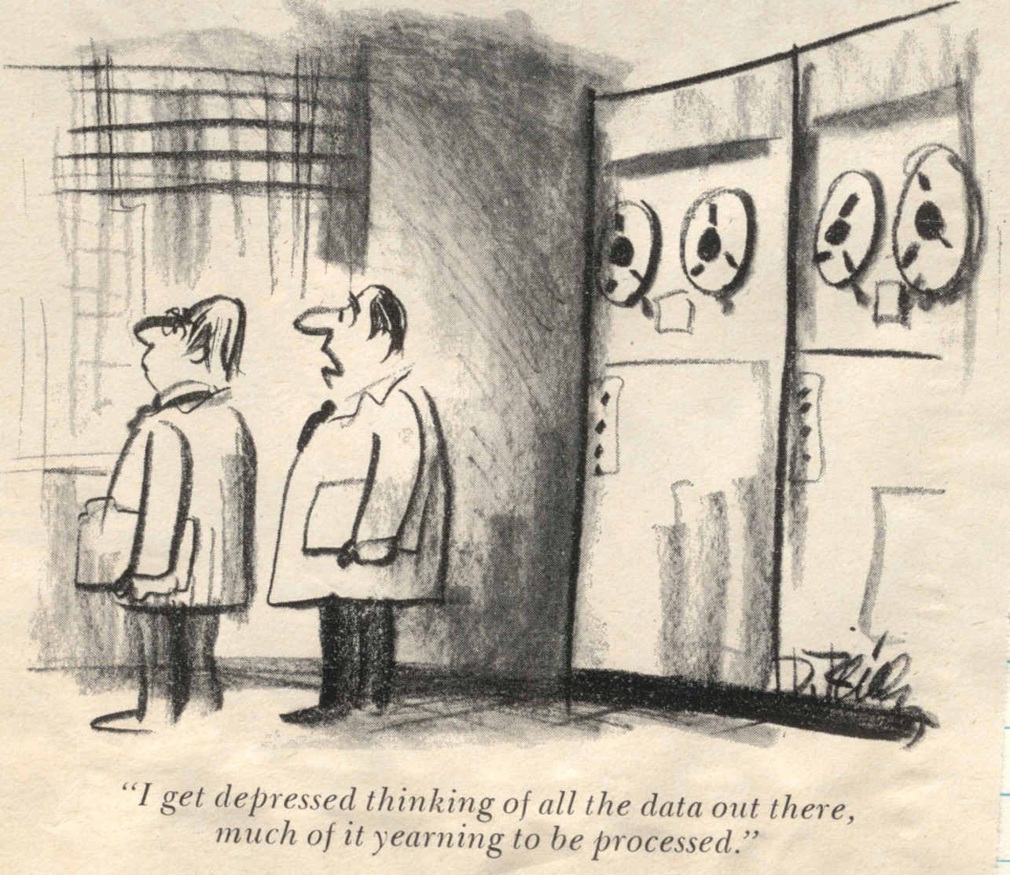
Big Data and Me and You
CS6907-13: Big Data and Analytics

Slide 3
There's a Wealth of Data out there, but……….
Organizations have access to a wealth of information, but they can’t get value out of it because it is sitting in its most raw form or in a semistructured or unstructured format; and as a result, they don't even know whether it's worth keeping (or even able to keep it for that matter).
Did you know that :
80 percent of the world's information is unstructured.
Unstructured information is growing at 15 times the rate of structured information.
Raw computational power is growing at such an enormous rate that today's off-the-shelf commodity box is starting to display the power that a supercomputer showed half a decade ago.
Access to information has been democratized: it is (or should be) available for all.
- Understanding Big Data: Analytics for Enterprise Class Hadoop and Streaming Data, 2012
CS6907-13: Big Data and Analytics
Intro-<number>

Slide 4
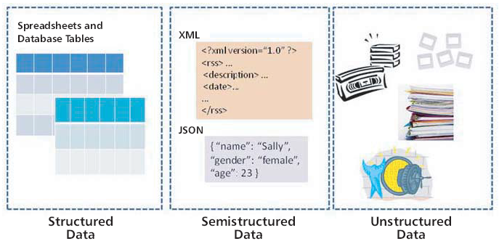
What is Big Data?
CS6907-13: Big Data and Analytics

Slide 5
Types of Data
Structured vs. Unstructured
  Structured:
    Usually has a defined length and format
    Ex: numbers, dates, strings
    Probably accounts for about 20% of all the data out there
    Usually stored in a file or a database (as records or tables)
  Unstructured Data:
    Data that does not follow a specific format
    Accounts for the other 80% of data
    Ex: documents, images, video, audio, sets of data
  Semistructured Data:
    Falls between the other two
    May not conform to a fixed schema, but may be self-defining
    Ex: RDF, XML, linked data
CS6907-13: Big Data and Analytics

Slide 6
What is Big Data?
a,b,c,d,e
….
….
v,w,x,y,z
Few attributes (< 20 or so)
Lots of records (tens to hundreds of millions)
Attributes may have a wide range of values
Attributes often same type (numeric or alphanumeric)
Many attributes (hundreds to thousands)
Many records (but not tens of millions)
Attributes have mixed data types (possibly XML, RDF)
Attributes have varying value ranges
a,b,c,d,e,f,g,h,I,j,k…
a,b,c,d,e,f,g,h,I,j,k…
……
……
l,m,n,o,p,q,r,s,t,u,…
Some combination of the above
Both large width and large depth
CS6907-13: Big Data and Analytics

Slide 7
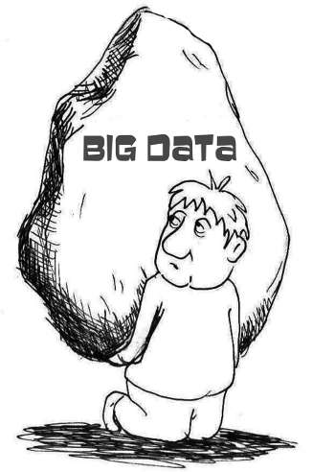
Big Data: A Definition
Big Data can be defined as the amount of data just beyond technology’s capability to store, manage and process efficiently.
CS6907-13: Big Data and Analytics

Slide 8
Big Data: What is it?
The situation where our most difficult problem is not how to store the data, but how to process it in meaningful ways
It is estimated that 70-85% of all data is unstructured text, audio and images (and rising!)
  In the past 50 years, the New York Times produced 3 billion words.
  Twitter users produce 8 billion words – every single day
    Most of it semistructured: Why??
  *Source: Kalev Leetaru, University of Illinois
More data is not simply more data, but more data is different!
CS6907-13: Big Data and Analytics

Slide 9
Big Data Is Evolutionary
A terabyte size (10¹²) data warehouse used to be Big Data
  Now, some data warehouses store tens of petabytes of data
New analytical platforms have emerged to store and analyze Big Data
And, its creation and aggregation are accelerating,
Petabytes (10¹⁵) → Exabytes (10¹⁸) → Zettabytes (10²¹)
  - Total created in 2010 would fill 75 billion 16 GByte iPads
  - 1 Zettabyte = 1 Billion 1TB Disk Drives
CS6907-13: Big Data and Analytics

Slide 10
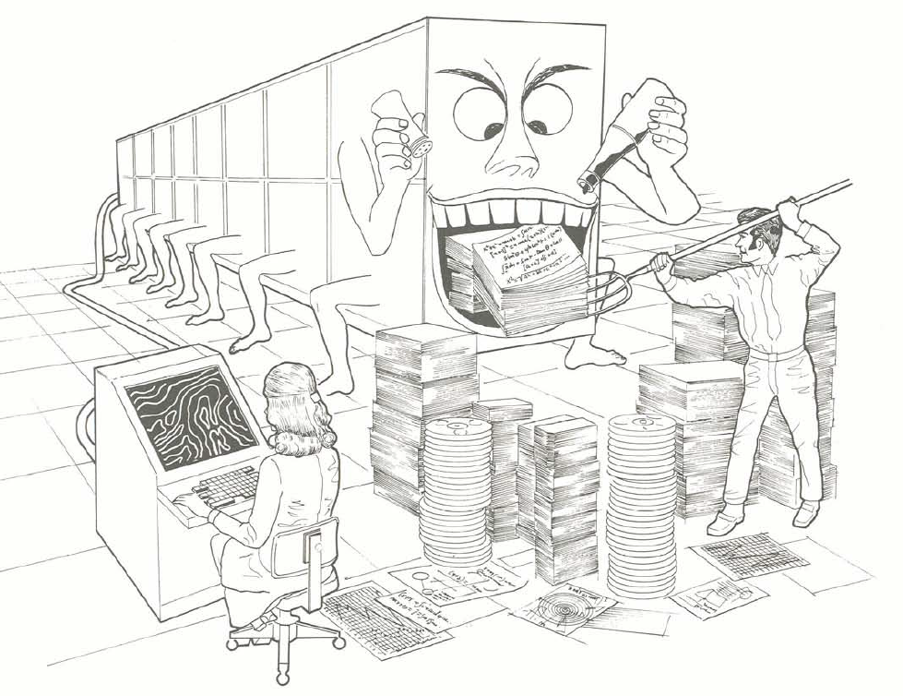
Can Processing Keep Up?
Ref: Burroughs Corp. 1974. Illiac IV (brochure)
CS6907-13: Big Data and Analytics

Slide 11
Big Data: Where is it?
5,000,000,000 mobile phones in use in 2010
  12% were smartphones, but these are growing by 20% per year
  9,000,000 iPhone5s’s sold during initial weekend - 2013
40% growth in global data is estimated per year
  But, only 5% growth in IT spending ← Uh oh!!
  Where and How will we store all this data?
30,000,000,000 items shared on Facebook every month
Lots of Big Data is legacy data that has never been analyzed
  1999: A Teradata customer created a 130 TB database
Library of Congress:
  In April 2011, LOC had total storage of 235 Terabytes of data
From the Cisco Visual Index Global Mobile Data Traffic Forecast Update, 2012:
  The projected world population by 2016 would be 7.3 Billion. What is the projected mobile connected devices by then?
    Answer: 1.4 mobile devices per person
  Video now accounts for over half of all Mobile device traffic bandwidth (52%). By 2016 over 70%.
Ref: McKinsey Global Institute, Big Data: The Next Frontier for innovation, Competition, and Productivity, May 2011 and others
CS6907-13: Big Data and Analytics

Slide 12
Some More Data
Facebook:
  4.5 billion likes generated daily as of May 2013
  968 million people log onto Facebook daily (DAU) for June 2015
  Photo uploads total 300 million per day
  Photo uploads total 300 million per day (Ref: The Social Skinny)
  At 1.49 billion, Facebook has more monthly active users than WhatsApp (500 million), Twitter (284 million) and Instagram (200 million)—combined.
Twitter:
  Registered Twitter Users (10/25/2015) – ~ 650 million
  Active users: ~289 million (10/25/2015)
  Average # followers per user: 208 (10/11/2012)
  Average # tweets per day: ~58 million (or 1.58 billion byes)
CS6907-13: Big Data and Analytics

Slide 13
Big Data: Characteristics
Doug Laney (Meta Group, now Gartner):
  Volume: Total number of bytes associated with the data.
  Velocity: The pace at which data are to be consumed. As volumes rise, the value of individual data points tend to more rapidly diminish over time.
  Variety: The complexity and different representations of the data, which limits the utility of traditional means of analysis.
Gartner suggests an additional feature:
  Variability: The differing ways in which the data may be interpreted. Differing questions require differing interpretations.
Kaisler, Armour, Espinosa and Money:
  Value: The relative importance of different data to the decision-making process.
But, Kaisler, Armour, Espinosa and Money also suggest:
  Veracity: The reliability, accuracy and fidelity of the data
CS6907-13: Big Data and Analytics

Slide 14
Measuring the Value of Big Data
Top 5 Advantages of Successfully Managing Big Data*
Improving Overall Agency Efficiency
Improving Speed/Accuracy of Decision Making
Ability to Forecast Events
Ease of Identifying Opportunities for Savings
Greater Understanding of Citizens Needs
* Based on Meritalk Research survey of 151 federal IT professionals – The Big Data Gap, May 2012
CS6907-13: Big Data and Analytics

Slide 15



An Emerging Problem (Still!)
Big Data existed but often went unanalyzed. Why?
Too large to manage
Too much and too costly to store
Lack of “analytic ability/power/time” to use
Big Data
DATA SIZE
Information
Overload
Relevant Data
Now
Soon
The Future
CS6907-13: Big Data and Analytics

Slide 16
Analytics
It is the scientific process of transforming data into insight for making better decisions (INFORMS)
  Still in the “emerging state“
  (Bloomberg Businessweek survey of 930 businesses)
There is a Lack of analytical talent:
  By 2018, the US faces a shortage of 140,000 to 190,000 people with deep analytical skills
  And, 1.5 million managers and analysts to analyze big data and make decisions (McKinsey Global Institute, 2011)
  Are you maybe one of these??
New analytics are being developed and applied to new domains
CS6907-13: Big Data and Analytics

Slide 17
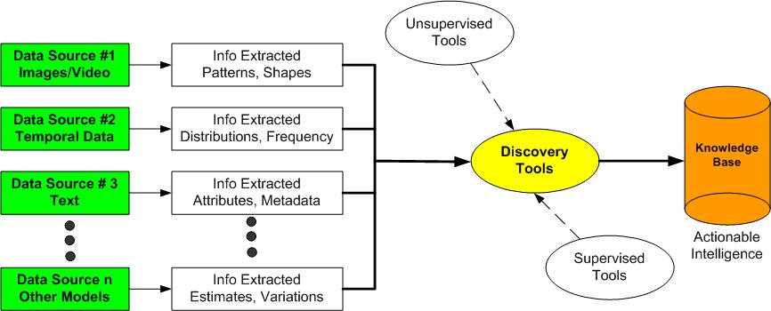
Goal: Transforming Data To Knowledge
Data – Information – Knowledge – Action/Decision
Realize that data is the only resource that humans have that the act of consumption creates more of the resource!!
Very Important!
CS6907-13: Big Data and Analytics

Slide 18
Data Science
“Is a set of fundamental principles that guide the extraction of knowledge from data.”
(Provost & Fawcett, Data Science for Business)
Hal Varian, Mckinsey Quarterly, January 2009:
“The sexy job in the next ten years will be statisticians… The ability to take data—to be able to understand it, to process it, to extract value from it, to visualize it, to communicate it—that’s going to be a hugely important skill.”
http://www.mckinseyquarterly.com/Hal_Varian_on_how_the_Web_challenges_managers_2286
Data scientists have advanced training in multivariate statistics, artificial intelligence, machine learning, mathematical programming, and simulation to perform descriptive, estimative, and predictive analytics. And, often hold Ph.D.’s
CS6907-13: Big Data and Analytics

Slide 19
Data Mining
“Is the computational process of discovering trends in data” (ACM)
A subset of Data Science
It incorporates machine learning, statistics and database systems.
It is about extracting patterns and knowledge and identifying previously unknown relationships in the data.
  Cluster analysis; anomaly detections; associations; relations
Used for hypotheses development and validation
CS6907-13: Big Data and Analytics

Slide 20
Statistical Machine Learning
Statistical Machine Learning refers to analytics models that learn from the data as the data changes
  Q: What actually do they learn?
Training data: data used to build the models by associating predictors (or rules) with outcomes; e.g., spam filtering
Test data: data used to test the models by evaluating if the models predicted new data outcomes correctly
Unsupervised learning: no target group specified; e.g., clustering; co-occurrence grouping; profiling; density estimates; pattern discovery; customer categorization.
Supervised learning: specific target specified – e.g., which loan clients are more likely to default on their loan? regression; predictions.
CS6907-13: Big Data and Analytics

Slide 21
R: What is it?
R is a language and environment for statistical computing and graphics**.
R provides a wide variety of statistical (linear and nonlinear modelling, classical statistical tests, time-series analysis, classification, clustering, …) and graphical techniques.
R is highly extensible.
One of R’s strengths is the ease with which well-designed publication-quality plots can be produced, including mathematical symbols and formulae where needed.
R is available as Free Software under the terms of the Free Software Foundation’s GNU General Public License in source code form.
It compiles and runs on a wide variety of UNIX platforms and similar systems (including FreeBSD and Linux), Windows and MacOS.
**No longer true. It is a general-purpose computational environment.
CS6907-13: Big Data and Analytics

Slide 22
Getting Started w/ R
R: powerful open source object-oriented programming language for statistical work:
  literally thousands of publicly available libraries for most statistical work
  Download R from one of the CRAN Mirrors: www.r-project.org
  Manuals: http://cran.r-project.org/doc/manuals/
  Several R books will be posted on Blackboard
R Studio is a popular free software tool to manage R projects
  R Studio (http://www.rstudio.com/);
  RSeek (http://www.rseek.org/)
CS6907-13: Big Data and Analytics

Slide 23
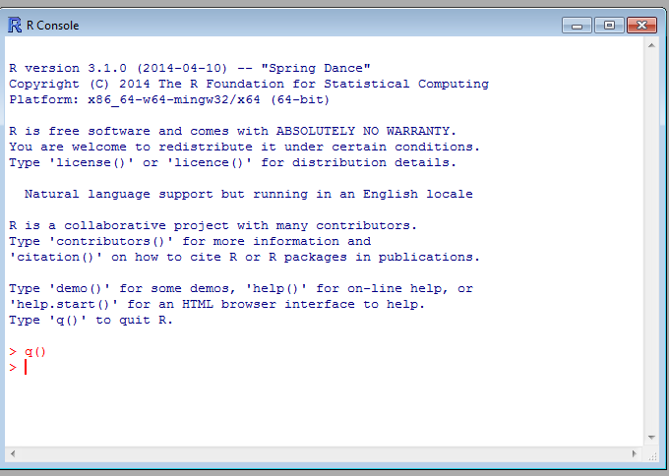
The R Console
CS6907-13: Big Data and Analytics

Slide 24
Observations About R
R is a command line oriented program.
  You will make a lot of typing mistakes.
  Thus, use RStudio which provides a text editor
Use the First() function to configure your environment upon startup.
Use the initialization files:
  Put in .Rprofile for local configuration or Rprofile for global configuration.
CS6907-13: Big Data and Analytics

Slide 25
The R Environment
R is an integrated suite of software facilities for data manipulation, calculation and graphical display.
It includes:
  an effective data handling and storage facility,
  a suite of operators for calculations on arrays, in particular matrices,
  a large, coherent, integrated collection of intermediate tools for data analysis,
  graphical facilities for data analysis and display either on-screen or on hardcopy, and
  a well-developed, simple and effective programming language which includes conditionals, loops, user-defined recursive functions and input and output facilities.
The term “environment” is intended to characterize it as a fully planned and coherent system, rather than an incremental accretion of very specific and inflexible tools, as is frequently the case with other data analysis software.
CS6907-13: Big Data and Analytics

Slide 26
R Packages
There are lots and lots of them!!
Avoid the ones that are no longer supported!
Explore the packages that are available
Make use of as many packages as you can; it will simplify your working the class projects
When downloading an R package, also download its .pdf file that describes how to use the package.
CS6907-13: Big Data and Analytics

Slide 27
RStudio
Download RStudio: (Optional)
  http://www.rstudio.com/products/rstudio/
RStudio is an integrated development environment (IDE) for R.
It includes a console, syntax-highlighting editor that supports direct code execution, as well as tools for plotting, history, debugging and workspace management.
CS6907-13: Big Data and Analytics

Slide 28
R: Workspaces
During an R session, all objects are stored in a temporary, working memory
List objects
  ls()
Remove objects
  rm()
Objects that you want to access later must be saved in a “workspace”
  from the menu bar: File->save workspace
  from the command line: save(x,file=“MyData.Rdata”)
Naming conventions:
  must start with a letter (A-Z or a-z)
  can contain letters, digits (0-9), and/or periods “.”
    case-sensitive
    mydata different from MyData
    do not use underscore “_”
CS6907-13: Big Data and Analytics

Slide 29
R: History
Command line history
Can be saved and loaded
  savehistory(file=“MyData.Rhistory)
  loadhistory(file=“MyData.Rhistory)
Display history
  history(max.show=Inf)
During a session you can use the arrow keys to review the command history
CS6907-13: Big Data and Analytics

Slide 30
R: Basic Concepts
Variables and Functions:
> a = 49
> sqrt(a)
[1] 7
> a = "The dog ate my homework"
> sub("dog","cat",a)
[1] "The cat ate my homework“
> a = (1+1==3) Note the precedence here!!
> a
[1] FALSE
Interactive operation: you type into R console and you get a result
CS6907-13: Big Data and Analytics

Slide 31
R: Basic Concepts
Structures: vectors, matrices and arrays
vector: an ordered collection of data of the same type
> a = c(1,2,3)
> a*2
[1] 2 4 6
or
a<-matrix(data=0,nr=1,nc=3)
In R, a single number is the special case of a vector with 1 element.
Other vector types: character strings, logical values
matrix: a rectangular table of data of the same type
array: 3-,4-,..dimensional matrix
CS6907-13: Big Data and Analytics

Slide 32
R: Basic Concepts
Lists
list: an ordered collection of data of arbitrary types.
> doe = list(name="john",age=28,married=F)
> doe$name Note: accessing elements by ‘$’ operator
[1] "john“
> doe$age
[1] 28
Typically, vector elements are accessed by their index (an integer), list elements by their name (a character string).
But both types support both access methods.
CS6907-13: Big Data and Analytics

Slide 33
R: Basic Concepts
Data Frames:
Represents the typical data table that researchers come up with – like a spreadsheet.
A rectangular table with rows and columns:
  data within each column has the same type (e.g. number, text, logical)
  different columns may have different types.
Example:
> a
localisation tumorsize progress
XX348 proximal 6.3 FALSE
XX234 distal 8.0 TRUE
XX987 proximal 10.0 FALSE
CS6907-13: Big Data and Analytics

Slide 34
R: Basic Concepts
A character string can contain arbitrary text.
  Sometimes it is useful to use a limited vocabulary, with a small number of allowed words.
  A factor is a variable that can only take such a limited number of values, which are called levels.
> a
[1] Kolon(Rektum) Magen Magen
[4] Magen Magen Retroperitoneal
[7] Magen Magen(retrogastral) Magen
Levels: Kolon(Rektum) Magen Magen(retrogastral) Retroperitoneal
> class(a)
[1] "factor"
> as.character(a)
[1] "Kolon(Rektum)" "Magen" "Magen"
[4] "Magen" "Magen" "Retroperitoneal"
[7] "Magen" "Magen(retrogastral)" "Magen"
> as.integer(a)
[1] 1 2 2 2 2 4 2 3 2
> as.integer(as.character(a))
[1] NA NA NA NA NA NA NA NA NA NA NA NA
Warning message: NAs introduced by coercion
Note: ‘ as‘ allows you to display in different formats
CS6907-13: Big Data and Analytics

Slide 35
R: Basic Concepts
Subsetting:
Individual elements of a vector, matrix, array or data frame are accessed with “[ ]” by specifying their index, or their name
> a
localisation tumorsize progress
XX348 proximal 6.3 0
XX234 distal 8.0 1
XX987 proximal 10.0 0
> a[3, 2]
[1] 10
CS6907-13: Big Data and Analytics

Slide 36
R: Subsetting
> a["XX987", "tumorsize"]
[1] 10
> a["XX987",]
localisation tumorsize progress
XX987 proximal 10 0
> a[c(1,3),] ; subset rows by a vector of indices
localisation tumorsize progress
XX348 proximal 6.3 0
XX987 proximal 10.0 0
CS6907-13: Big Data and Analytics

Slide 37
R:Subsetting
a[c(T,F,T),] ; subset rows by a logical vector
localisation tumorsize progress
XX348 proximal 6.3 0
XX987 proximal 10.0 0
> a$localisation ; subset a column
[1] "proximal" "distal" "proximal„
CS6907-13: Big Data and Analytics

Slide 38
R:Subsetting
a$localisation=="proximal“
; comparison resulting in logical vector
[1] TRUE FALSE TRUE
a[ a$localisation=="proximal", ]
; subset the selected rows
localisation tumorsize progress
XX348 proximal 6.3 0
XX987 proximal 10.0 0
CS6907-13: Big Data and Analytics

Slide 39
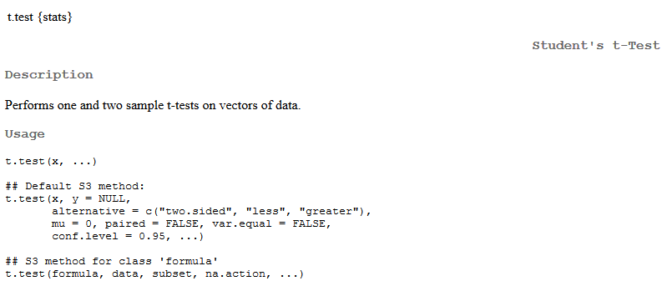
R: Basic Concepts
Getting help for a function name
>help(t.test)
starting httpd help server ... Done
In a separate browser window:
And, more and that’s for sure….
CS6907-13: Big Data and Analytics

Slide 40
R: Basic Concepts
Grouped expressions
  R is an expression language in the sense that its only command type is a function or expression which returns a result.
  Commands may be grouped together in braces, {expr 1, . . ., expr m}, in which case the value of the group is the result of the last expression in the group evaluated.
Control statements
  if statements
  The language has available a conditional construction of the form
    if (expr 1) expr 2 else expr
    where expr 1 must evaluate to a logical value and the result of the entire expression is then evident.
  a vectorized version of the if/else construct, the ifelse function.
    ifelse(condition, a, b)
CS6907-13: Big Data and Analytics

Slide 41
R: Basic Concepts
Repetitive Execution:
for loops, repeat and while
  for (name in expr 1) expr 2
    where name is the loop variable.
    expr 1 is a vector expression, (often a sequence like 1:20), and
    expr 2 is often a grouped expression with its sub-expressions written in terms of the dummy name.
    expr 2 is repeatedly evaluated as name ranges through the values in the vector result of expr 1.
  repeat expr statement
  while (condition) expr statement.
  The break statement can be used to terminate any loop, possibly abnormally.
    The only way to terminate repeat loops.
  The next statement can be used to discontinue one particular
  cycle and skip to the “next”.
CS6907-13: Big Data and Analytics

Slide 42
R: Importing Data
read.table()
  reads in data from an external file
data.entry()
  create object first, then enter data
c()
  concatenate
scan()
  prompted data entry
start editor and save changes
  data.entry(x)
start editor, changes not saved
  de(x)
start text editor
  edit(x)
CS6907-13: Big Data and Analytics

Slide 43
Defining a Function
Suppose you want to multiply a fractional number by 100, round to one decimal place, and print the number with a % after the rounded number.
addPercent <- function(x)
{
percent <- round(x * 100, digits = 1)
result <- paste(percent, “%’, sep = “”)
return(result)
}
Note:
-addPercent is the name of the function
-function must always be followed by (), possibly with parameters
-body of function is enclosed in {…}
-return(…) is used to return a result
CS6907-13: Big Data and Analytics

Slide 44
Installing Packages
install.packages("readr")
also installing the dependencies ‘Rcpp’, ‘curl’, ‘BH’
trying URL 'http://cran.rstudio.com/bin/windows/contrib/3.1/Rcpp_0.12.0.zip‘
Content type 'application/zip' length 3131494 bytes (3.0 Mb)
opened URL
downloaded 3.0 Mb
trying URL 'http://cran.rstudio.com/bin/windows/contrib/3.1/curl_0.9.3.zip‘
Content type 'application/zip' length 4384774 bytes (4.2 Mb)
opened URL
downloaded 4.2 Mb
trying URL 'http://cran.rstudio.com/bin/windows/contrib/3.1/BH_1.58.0-1.zip‘
Content type 'application/zip' length 13846661 bytes (13.2 Mb)
opened URL
downloaded 13.2 Mb
trying URL 'http://cran.rstudio.com/bin/windows/contrib/3.1/readr_0.1.1.zip‘
Content type 'application/zip' length 1128326 bytes (1.1 Mb)
opened URL
downloaded 1.1 Mb
package ‘Rcpp’ successfully unpacked and MD5 sums checked
package ‘curl’ successfully unpacked and MD5 sums checked
CS6907-13: Big Data and Analytics

Slide 45
Reading a File Using readr
library(readr)
Warning message: package ‘readr’ was built under R version 3.1.3
contents <- read_file("h:/Rdata/test1.txt")
Contents
[1] "Message-ID: <19874053.1075845747143.JavaMail.evans@thyme>\r\nDate: Tue, 13 Jun 2000 00:50:00 -0700 (PDT)\r\nFrom: gregg.penman@enron.com\r\nTo: kay.mann@enron.com\r\nSubject: Re: Revised RM Policy\r\nMime-Version: 1.0\r\nContent-Type: text/plain; charset=us-ascii\r\nContent-Transfer-Encoding: 7bit\r\nX-From: Gregg Penman\r\nX-To: Kay Mann\r\nX-cc: \r\nX-bcc: \r\nX-Folder: \\Kay_Mann_June2001_1\\Notes Folders\\Chicago\r\nX-Origin: MANN-K\r\nX-FileName: kmann.nsf\r\n\r\nPer my voice mail, will you please take a quick look at my edits to Vlady's \r\ndraft risk management policy attached below. I don't think any of them are \r\nproblematic, but Vlady has some concerns mainly because the base Enron Corp. \r\nrisk management policy was used as the template and therefore I am \r\neffectively making edits to it.\r\n\r\nI will be leaving the office today around 11:00 so I want to turn this to \r\nPeoples before then if possible. On any other business, I will be \r\nunavailable from 1:30 to probably 3:00 today, but can be reached via pager \r\n800-980-1771 or cell phone 312-925-8888 at any other time.\r\n\r\nAs always - thanks for your help.\r\n\r\nGregg\r\n\r\n\r\n\r\n\r\n\r\n\r\n\r\n\r\n
See: http://blog.rstudio.org/2015/04/09/readr-0-1-0/
CS6907-13: Big Data and Analytics

Slide 46
The File’s Contents
Message-ID: <19874053.1075845747143.JavaMail.evans@thyme>
Date: Tue, 13 Jun 2000 00:50:00 -0700 (PDT)
From: gregg.penman@enron.com
To: kay.mann@enron.com
Subject: Re: Revised RM Policy
Mime-Version: 1.0
Content-Type: text/plain; charset=us-ascii
Content-Transfer-Encoding: 7bit
X-From: Gregg Penman
X-To: Kay Mann
X-cc:
X-bcc:
X-Folder: \Kay_Mann_June2001_1\Notes Folders\Chicago
X-Origin: MANN-K
X-FileName: kmann.nsf
Per my voice mail, will you please take a quick look at my edits to Vlady's
draft risk management policy attached below. I don't think any of them are
problematic, but Vlady has some concerns mainly because the base Enron Corp.
risk management policy was used as the template and therefore I am
effectively making edits to it.
I will be leaving the office today around 11:00 so I want to turn this to
Peoples before then if possible. On any other business, I will be
unavailable from 1:30 to probably 3:00 today, but can be reached via pager
800-980-1771 or cell phone 312-925-8888 at any other time.
As always - thanks for your help.
Gregg
CS6907-13: Big Data and Analytics

Slide 47
Alternatively, Use read_lines
line1<-read_lines("h:/Rdata/test1.txt")
Line1
[1] "Message-ID: <19874053.1075845747143.JavaMail.evans@thyme>“
[2] "Date: Tue, 13 Jun 2000 00:50:00 -0700 (PDT)“
[3] "From: gregg.penman@enron.com“
[4] "To: kay.mann@enron.com“
[5] "Subject: Re: Revised RM Policy“
[6] "Mime-Version: 1.0“
[7] "Content-Type: text/plain; charset=us-ascii“
[8] "Content-Transfer-Encoding: 7bit“
[9] "X-From: Gregg Penman“
[10] "X-To: Kay Mann“
[11] "X-cc: “
[12] "X-bcc: “
[13] "X-Folder: \\Kay_Mann_June2001_1\\Notes Folders\\Chicago“
[14] "X-Origin: MANN-K“
[15] "X-FileName: kmann.nsf“
[16] "“
[17] "Per my voice mail, will you please take a quick look at my edits to Vlady's “
[18] "draft risk management policy attached below. I don't think any of them are “
[19] "problematic, but Vlady has some concerns mainly because the base Enron Corp. “
[20] "risk management policy was used as the template and therefore I am “
[21] "effectively making edits to it.“
[22] "“
[23] "I will be leaving the office today around 11:00 so I want to turn this to “
[24] "Peoples before then if possible. On any other business, I will be “
[25] "unavailable from 1:30 to probably 3:00 today, but can be reached via pager “
[26] "800-980-1771 or cell phone 312-925-8888 at any other time.“
[27] "“
[28] "As always - thanks for your help.“
[29] "“
[30] "Gregg“
CS6907-13: Big Data and Analytics

Slide 48
Extracting Strings
Suppose we need to extract the name from an email address
>email<-colleen.koenig@enron.com
>parts<-str_sub(email,0,str_locate(email,”@”)-1)
>parts
[1] “colleen.koenig” “colleen.koenig”
>length(parts)
[1] 2
>parts[[1]]
[1] “colleen.koenig”
Then extract the parts of the name.
CSCi 6907-13 Big Data and Analytics
4-<number>

Slide 49
Mapping Strings to Numbers
Once you have the names, you can then translate them to numbers or indexes.
For example, firstname = “colleen” and lastname = “koenig” can be concatenated to form “colleenkoenig”
Or, you can use “colleen.koenig” as an index into a matrix
Or, you can create a vector in which the position of “colleen.koenig” is the unique id for that name
CSCi 6907-13 Big Data and Analytics
4-<number>

Slide 50
Character Vectors
Character strings are always double quoted
Vectors made of character strings:
> x=c("I","want","to","go","home")
> x
[1] "I" "want" "to" "go" "home"
Using rep():
> rep("bye",2)
[1] "bye" "bye"
Notice the difference using paste() (1 element):
> paste("I","want","to","go","home")
[1] "I want to go home"
CS6907-13: Big Data and Analytics
2-<number>

Slide 51
Vectors - I
A vector: x=c(100,101,102,103) Notation: [ ] are used to access elements in x
A vector of logical values:
> c(TRUE, FALSE, TRUE, FALSE, FALSE)
[1] TRUE FALSE TRUE FALSE FALSE
Extract 2nd element in x
> x[2]
[1] 101
Finding the length of a vector:
> length(c("aa", "bb", "cc", "dd", "ee"))
[1]
Extract 3rd and 4th elements in x
> x[3:4] # or x[c(3,4)]
[1] 102 103
> x
[1] 100 101 102 103
CS6907-13: Big Data and Analytics
2-<number>

Slide 52
Vectors - II
Arithmetic Operations:
> a = c(1, 3, 5, 7)
> b = c(1, 2, 4, 8)
> 5 * a
[1] 5 15 25 35
> a + b
[1] 2 5 9 15
> a / b
[1] 1.000 1.500 1.250 0.875
> u = c(10, 20, 30)
> v = c(1, 2, 3, 4, 5, 6, 7, 8, 9)
> u + v
[1] 11 22 33 14 25 36 17 28 39
Note: Shorter vector is recycled to match longer vector!
CS6907-13: Big Data and Analytics
2-<number>

Slide 53
Vectors - III
A new vector can be sliced from an existing vector:
> s = c("aa", "bb", "cc", "dd", "ee")
Define logical vector L
> L = c(FALSE, TRUE, FALSE, TRUE, FALSE)
> s[L]
[1] "bb" "dd"
> s[c(FALSE, TRUE, FALSE, TRUE, FALSE)]
[1] "bb" "dd"
CS6907-13: Big Data and Analytics
2-<number>

Slide 54
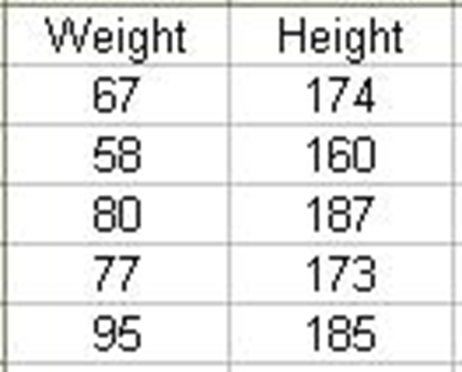
Matrices
A matrix is a table of different classes
Each column must be of the same class (e.g. numeric, character, etc.)
  The number of elements in each row must be identical.
Accessing elements in matrices:
x[row,column]
The ‘Height’ column:
> x[,”Height”] # or:
> x[,2]
Note: you cannot use “$”
> x$Weight
CS6907-13: Big Data and Analytics
2-<number>

Slide 55
Matrix Construction - I
> B = matrix( c(2, 4, 3, 1, 5, 7), nrow=3, ncol=2)
> B # B has 3 rows and 2 columns
[,1] [,2]
[1,] 2 1
[2,] 4 5
[3,] 3 7
> t(B) # transpose of B
[,1] [,2] [,3]
[1,] 2 4 3
[2,] 1 5 7
> C = matrix( c(7, 4, 2), nrow=3, ncol=1)
CS6907-13: Big Data and Analytics
2-<number>

Slide 56
Matrix Construction - II
Combine B and C
> cbind(B, C)
[,1] [,2] [,3]
[1,] 2 1 7
[2,] 4 5 4
[3,] 3 7 2
combine the rows of two matrices if they have the same number of columns with the rbind function.
> D = matrix(c(6, 2), nrow=1, ncol=2)
> D # D has 2 columns
[,1] [,2]
[1,] 6 2
> rbind(B, D)
[,1] [,2]
[1,] 2 1
[2,] 4 5
[3,] 3 7
[4,] 6
CS6907-13: Big Data and Analytics
2-<number>

Slide 57
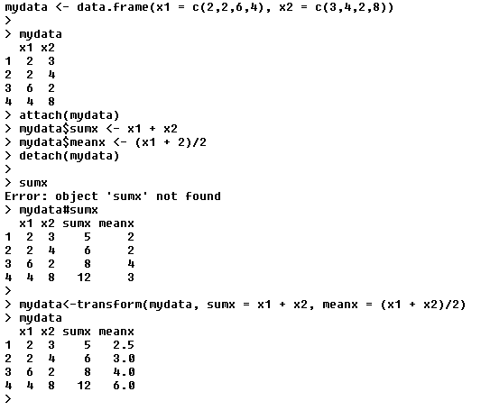
Using R’s Transform function
With this code, you obtain
the original data frame and
two vectors: sumx
and meanx – added into
the data frame
BUT: note the rounding in meanx!
So, use this form to force to
Floating point
CSCi 6907-13 Big Data and Analytics
4-<number>

Slide 58
What You Should Do This Week
Download R and install it on your machine
Download Rstudio and install it on your machine
Read some of the manuals on one of the CRAN mirrors
Play with R:
  Run the demos
  Try the Examples
  Create some files of your own using a word processor
  Learn to read text files and look at the R functions to see how to pick lines apart
Next Week: I will tell you what is expected for the project.
  I won’t tell you this week because I want you to learn about R
CS6907-13: Big Data and Analytics
Notes:
Describe your topic in one paragraph. Narrowly defined, topic on data science.
Citeseet
Ensemble methods

